Slide 1
Smart kid Montessori (skm)
Quang-Dung Ho
June 17, 2016

Slide 2
Project summary
To assist the management in a daycare center
To replace manual/paper-based operations by automatic/computerized operations

Slide 3
Project summary
To achieve the following objectives:
to save time
to save daily (tedious) labor
to improve workflows
to enhance productivity
to avoid mistakes (usually unavoidable in manual/paper-based operations)
to enhance/automate communications between employees (less time, never forget, …)
to save $ for the owners and to relieve employees’ stresses
to make the business high-tech, paperless (green mgt, save the trees, …)

Slide 4
Project summary
Users
Owner
Manager, secretary, finance staff
Educators
Parents
Beneficial for all users

Slide 5
Project summary
Features implemented
Security & App Access Controls
Employee Attendance
Student Attendance
Student-Educator Ratio Checks and Recommendations
Page Navigation (Page Tabs)
Mostly follows the initial plan
Many features to be completed in future
Finance-related, operation/education reports, …

Slide 6
Project summary
The focus is to build a skeleton of the app (not the whole app with full features)
Key features are implemented/tested
Cosmetic/artistic concerns are important but left for future (good excuse for the plain GUI’s for now)
Some assumptions are made to simplify the implementation

Slide 7
App requirements
Secure
Simple
User-friendly
Little time to learn how to use it (less than 15 minutes)
No software installation required in end-user devices
Faster, easier & more efficient than the existing workflow

Slide 8
How to meet app requirements?
Web application
Passcode log-in
App access control
No keyboard is required
Each operation is done with 1-3 screen taps
Numerous features are computerized
Page links/tabs for easy navigation

Slide 9
App value propositions
Existing Workflow
SKM Workflow
pens, papers, binders
hand-writings
several hours of data collection
several hours of calculations/analysis
data losses, mistakes
1 end-device (phone, tablet)
a few screen taps/clicks
nothing (SKM takes care)
nothing (SKM takes care)
no loss, no mistake

Slide 10
App value propositions
Existing Workflow
SKM Workflow
3 man-hours/day (3x30 = 90$)
60 man-hours/month (1,800$)
0.5 man-hours/day (0.5x30=15$)
10 man-hours/month (300$)
Money savings
Saving/month = 1,500$
Saving/year = 18,000$
Enhanced (physical/data) security
Data losses, mistakes avoided
Troubles/tickets/fines avoided

Slide 11
1. Security & app access controls
Conventional username-password log-in
Keyboard is required
Typing takes time (a few tens of seconds)
In daycare
Quite busy
Any operations with the app need to be faster than paperwork-based operations

Slide 12
1. Security & app access controls
Keypad log-in
No keyboard is required
Only the passcode to be entered (screen taps)
Quite fast to complete (a few seconds)
Very popular in various existing use cases

Slide 13
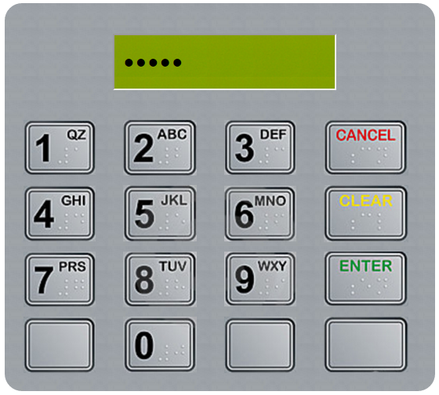
1. Security & app access controls
Physical keypad is emulated in the web interface
Security can be achieved with sufficiently long passcode
Example: 100 users/99999 codes = 10⁻³ = 0.1%

Slide 14
1. Security & app access controls
User access to features of the app is controlled
Owner: log-in, log-out, check-in/check-out, child reports + payments, schedulers, statistical reports, …
Educators: log-in, log-out, check-in/check-out, child reports
Administrators: + database monitoring, security monitoring, app usage statistics, …

Slide 15
2. employee attendance
Now done manually (report by email by the end of every day), then extra hours required to collect & process data
More than 35% forget to do, the manager/owner needs to remind employees by emails/phone-calls
If forget to do in the same day, 70% confusing/making mistakes when doing later
Time-consuming, accuracy issues
Lots of efforts required for employees and employer

Slide 16
2. employee attendance
Employee attendance check-in/check-out with a few taps
To be done when entering or leaving the school (by employees themselves)
Recorded data is used to
Monitor employee daily/weekly/monthly/yearly work
Support educational program managements
Support payments
etc.

Slide 17
3. student attendance
Now done manually (note down with pens/papers), then extra hours required to collect & process data
More than 35% forget to do, the manager/owner needs to remind employees by emails/phone-calls
If forget to do in the same day, 70% confusing/making mistakes when doing later
Time-consuming, accuracy issues, children security issues
Lots of efforts required for employees and employer

Slide 18
3. student attendance
Student attendance check-in/check-out with a few taps
To be done when entering or leaving the school (by educators/employees)
Recorded data is used to
Monitor student daily/weekly/monthly/yearly school participation
Support educational program managements
Support payments
etc.

Slide 19
4. student-educator ratio
Government Requirements
By law, daycare must ensure the required student-educator ratio at all time (Ex: max 5 students per educator)
Subject to be inspected by [Minister of Education, Recreation and Sports] (no advance notice)
Tickets/fines/closure orders could be given if violated
Challenges
Daycare environment is crowded and complicated
To ensure this, the manager needs to plan, keep monitoring, etc.
Lots of time and efforts required

Slide 20
4. student-educator ratio
Educator check-in/out
Student check-in/out
Alert if more educator(s) are required
Recommend if some educator(s) can leave
Avoid tickets/fines/closure orders
Mistakes avoidable
Less time/efforts
Money savings

Slide 21
5. Page navigations
Header and footer with information
Page tabs

Slide 22
Achievements
The skeleton of the app (database, web app framework) is designed and successful implemented
A number of key features are implemented/tested
Ready to be extended
Have learned lots of things (mySQL, PHP, Javascript, JQuery, …)

Slide 23
Challenges
Learn new things within a short time frame
Want to implement many other interesting features but time not allowed (email, SMS, …)
Testing/debugging with large data set & in various scenarios

Slide 24
Potential extensions
Adapted for various devices (phones, tablets, laptops, …)
Integrated with other tech’s
RFID for employee/student identifications
real-time location system
security/alarm/fire systems
smart building systems/applications
anything else?
Not sure if clients will be interested in?

Slide 25
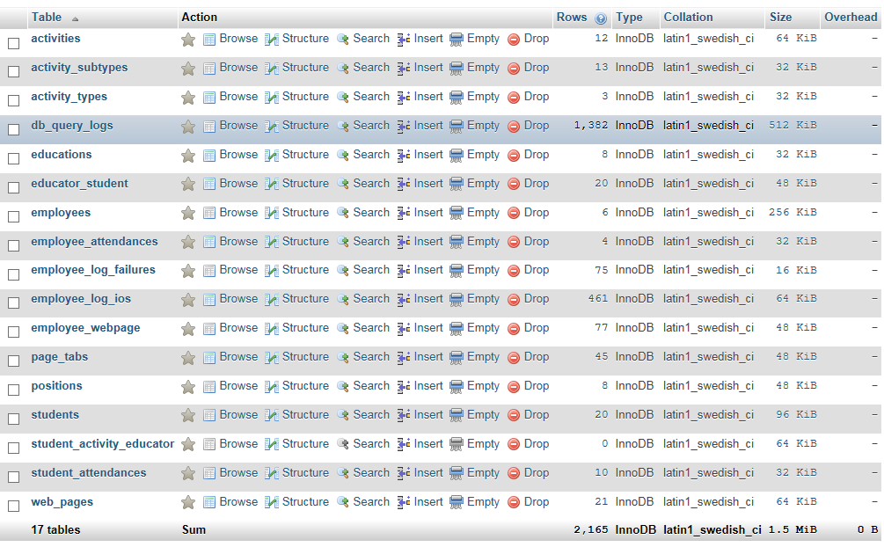
DATABASE
17 tables
20 student
6 employees
…

Slide 26
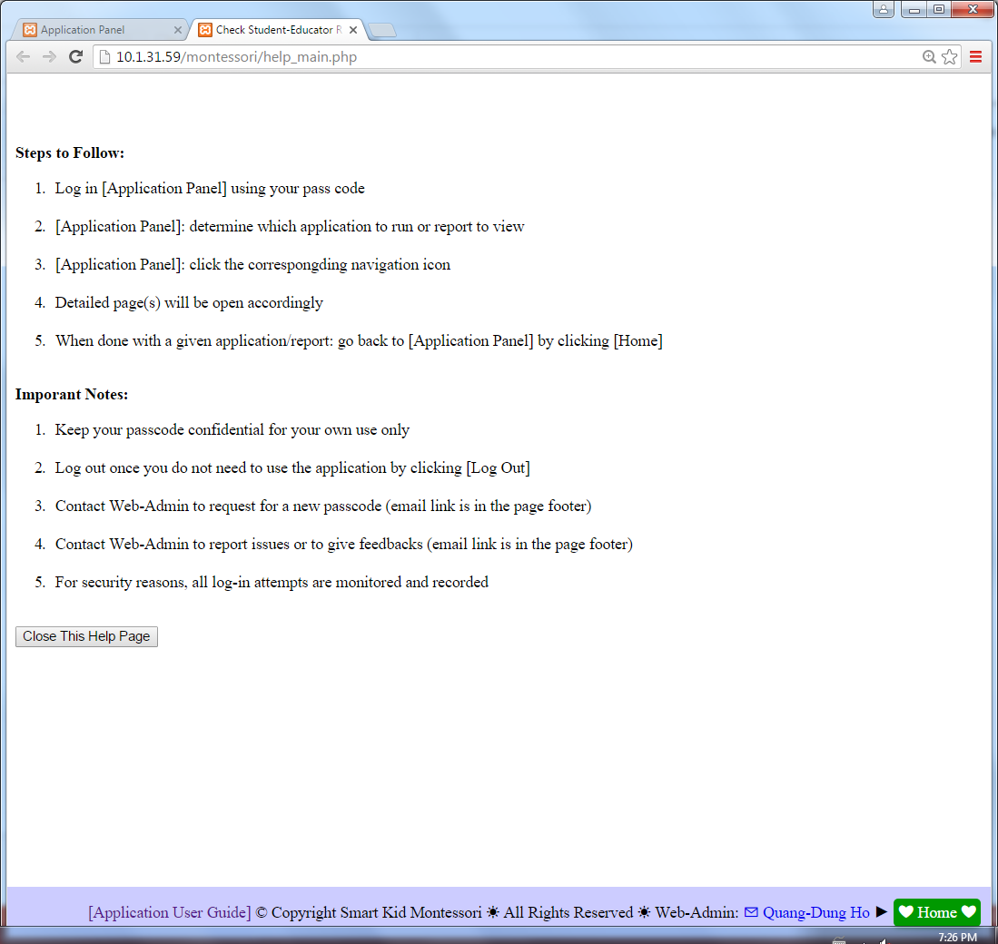
User Guide
Online help

Slide 27
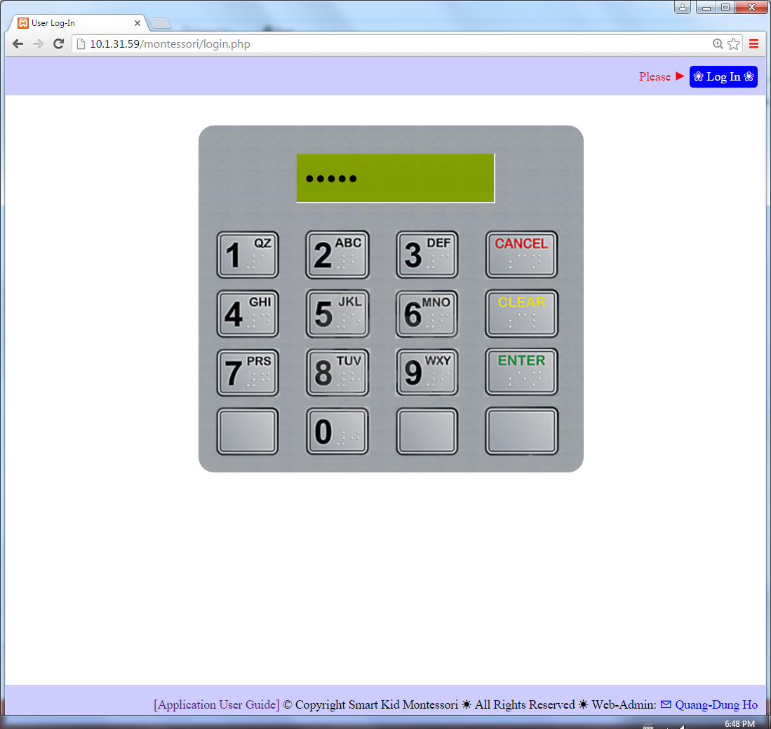
User Guide
Log-in using keypad

Slide 28
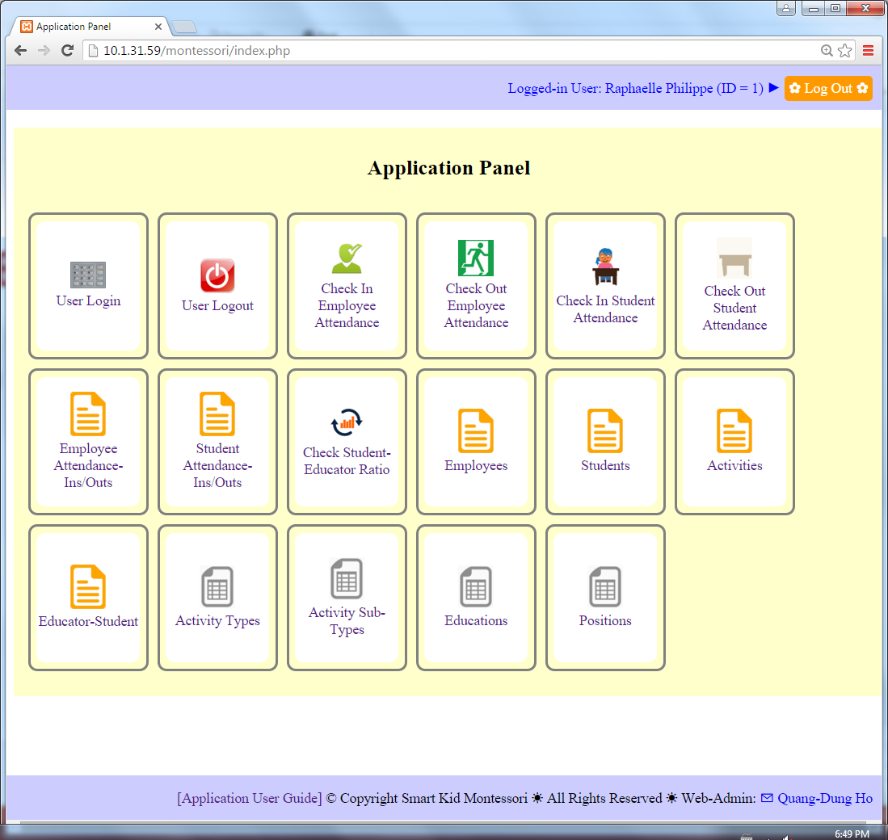
User Guide
Application Panel displaying features that the logged-in user is authorized

Slide 29
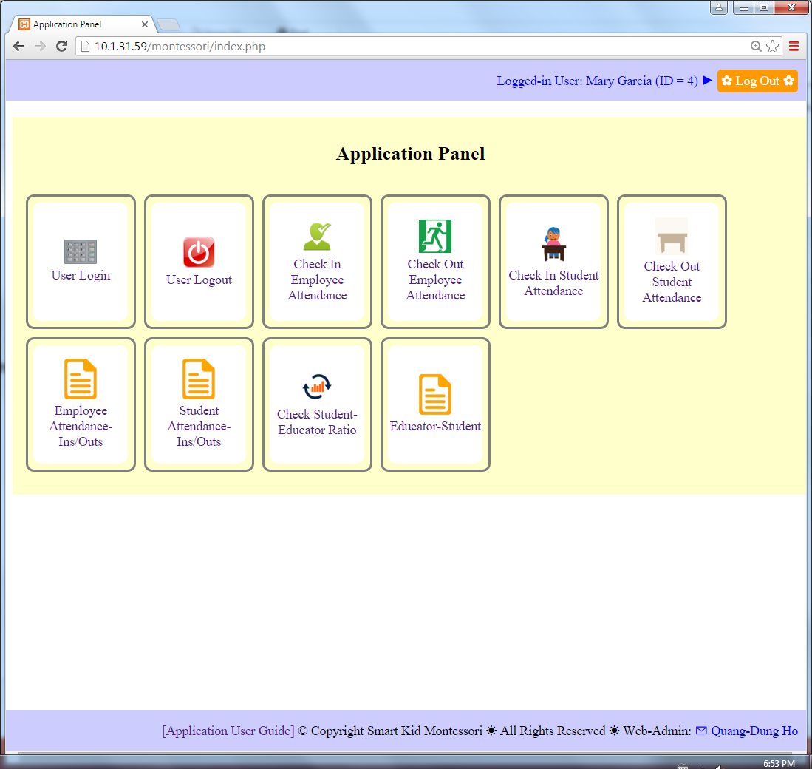
User Guide
Application Panel displaying features that the logged-in user is authorized

Slide 30
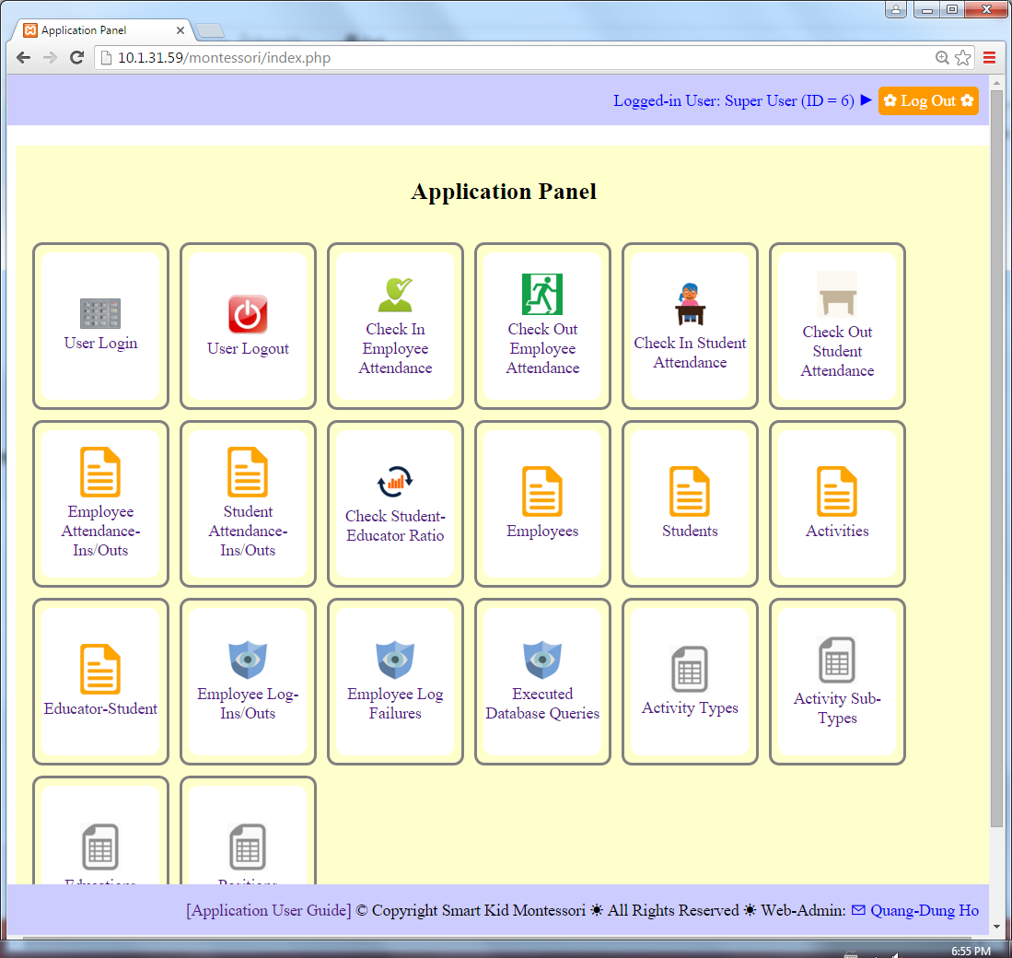
User Guide
Application Panel displaying features that the logged-in user is authorized

Slide 31
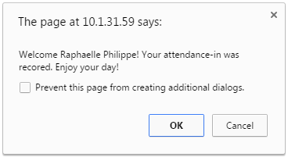
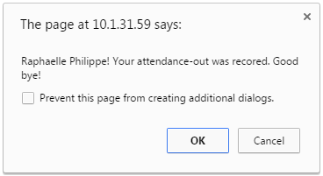
User Guide
Employee attendance check-in and check-in

Slide 32
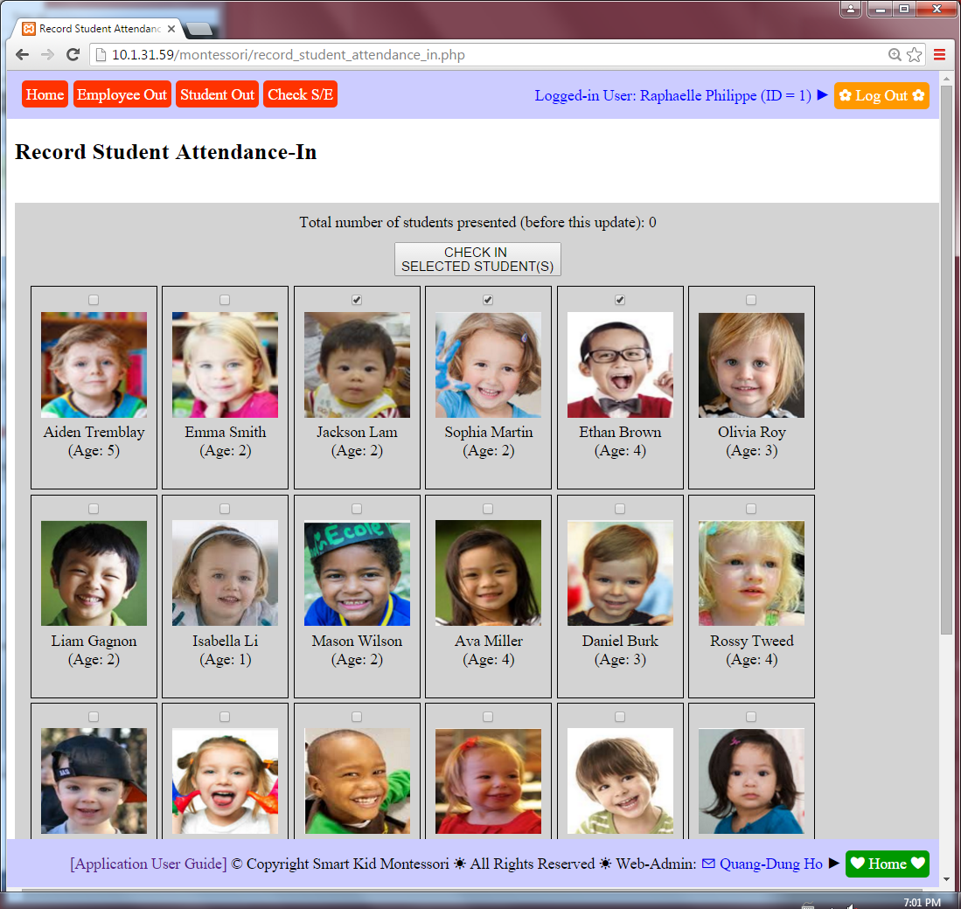
User Guide
Student attendance check-in

Slide 33
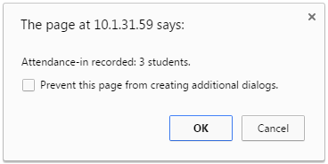
User Guide
Student attendance check-in

Slide 34
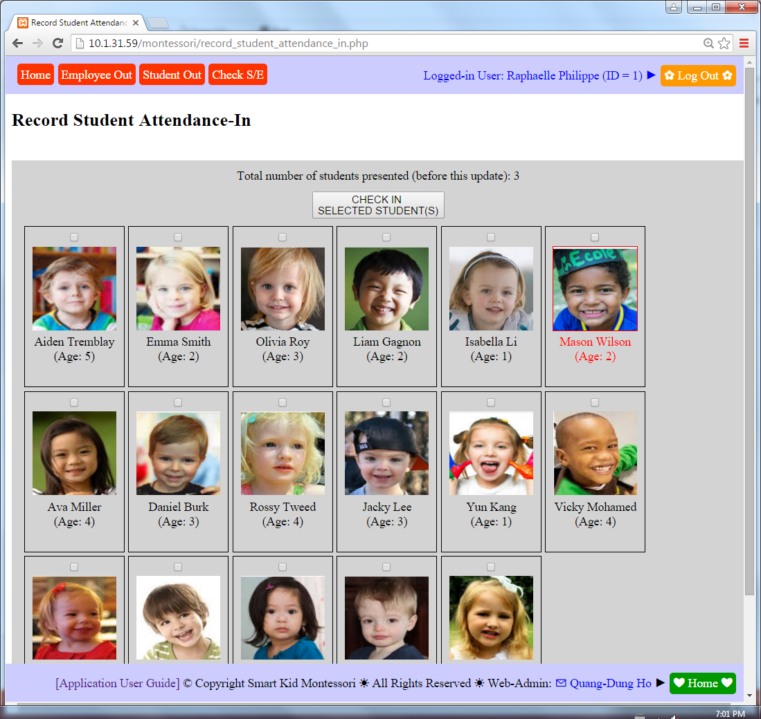
User Guide
Student attendance check-in

Slide 35
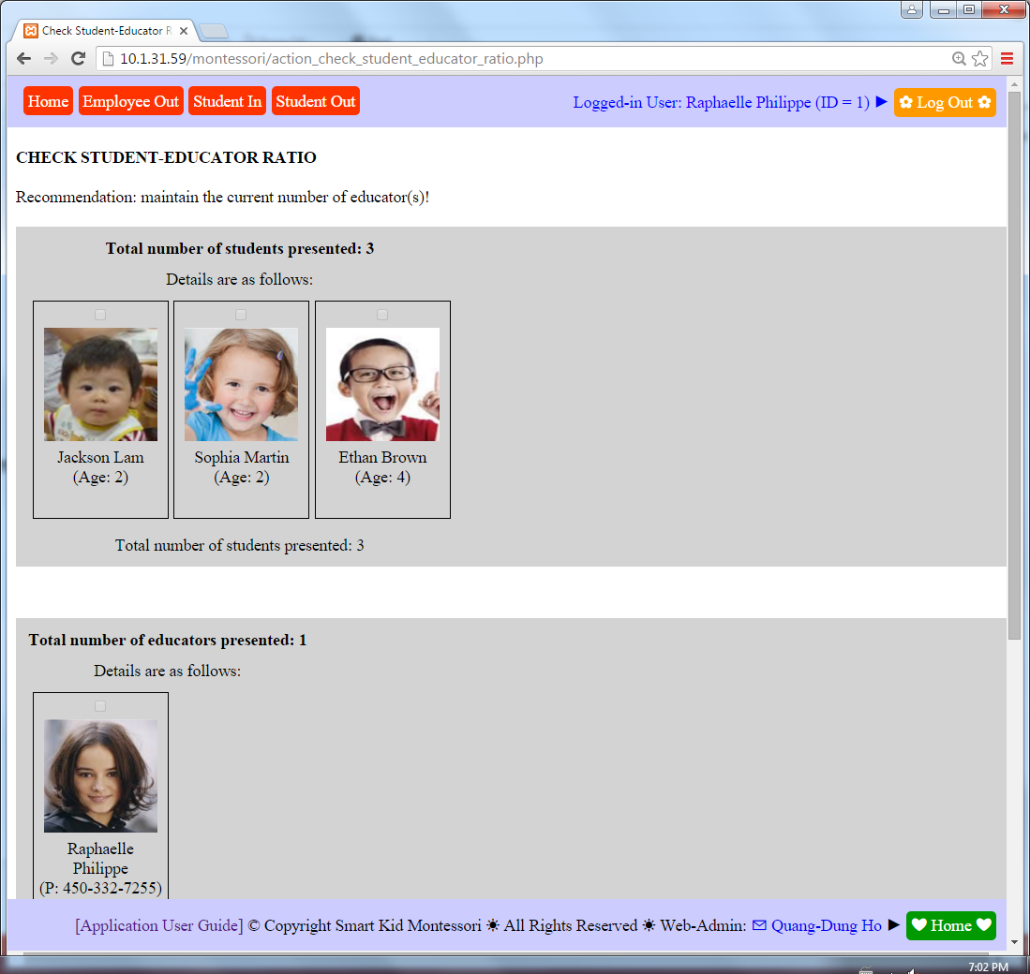
User Guide
Check Student-Educator Ratio & Recommendation

Slide 36
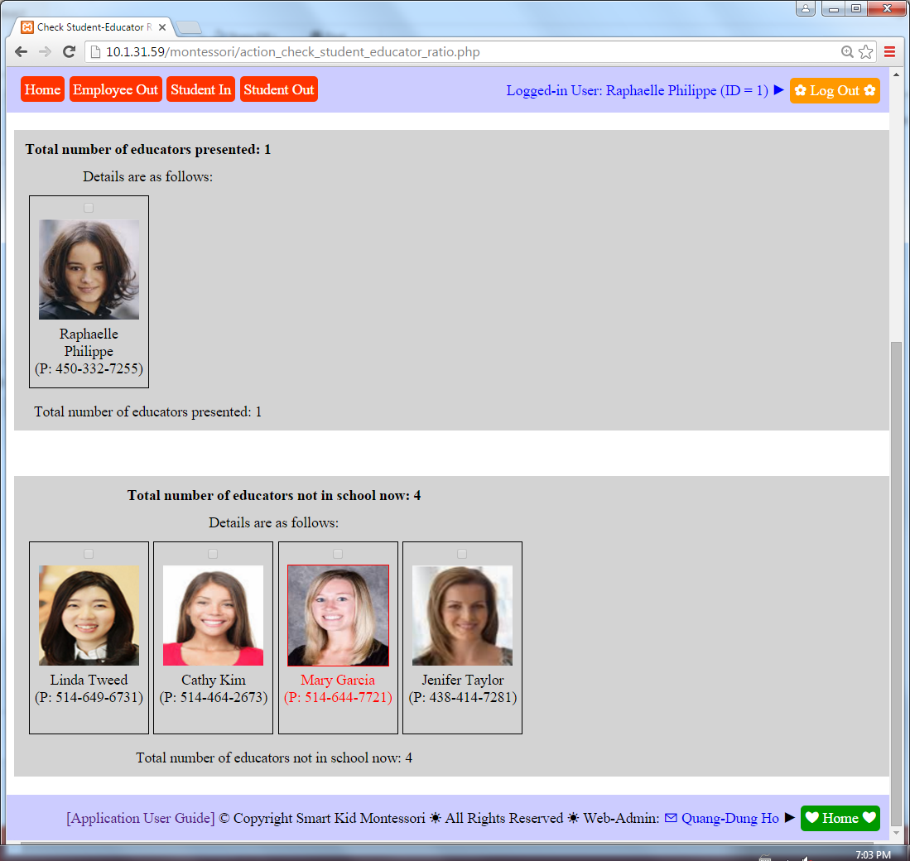
User Guide
Check Student-Educator Ratio & Recommendation

Slide 37
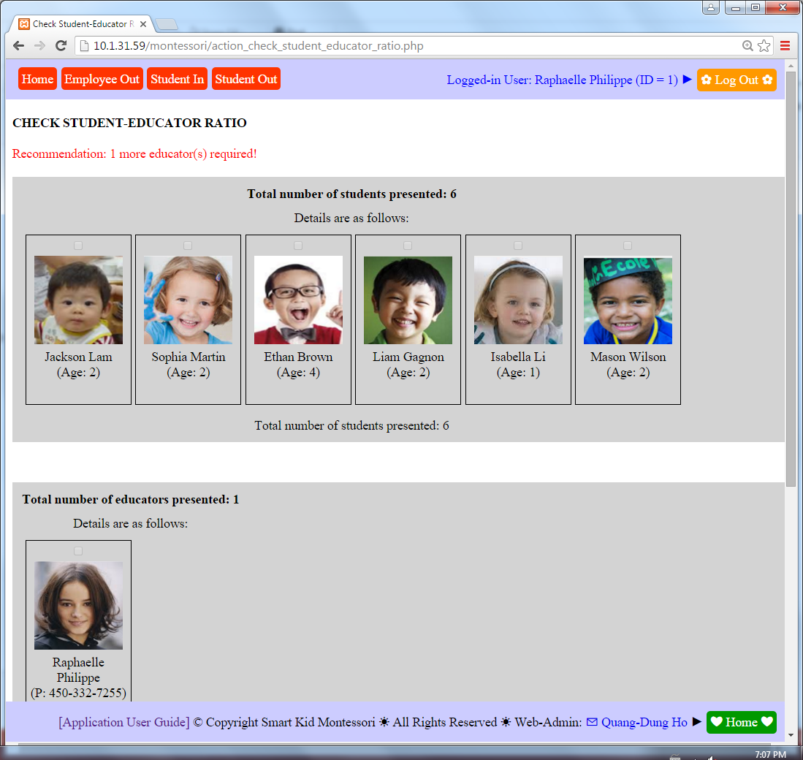
User Guide
Check Student-Educator Ratio & Recommendation

Slide 38
User Guide
Check Student-Educator Ratio & Recommendation

Slide 39
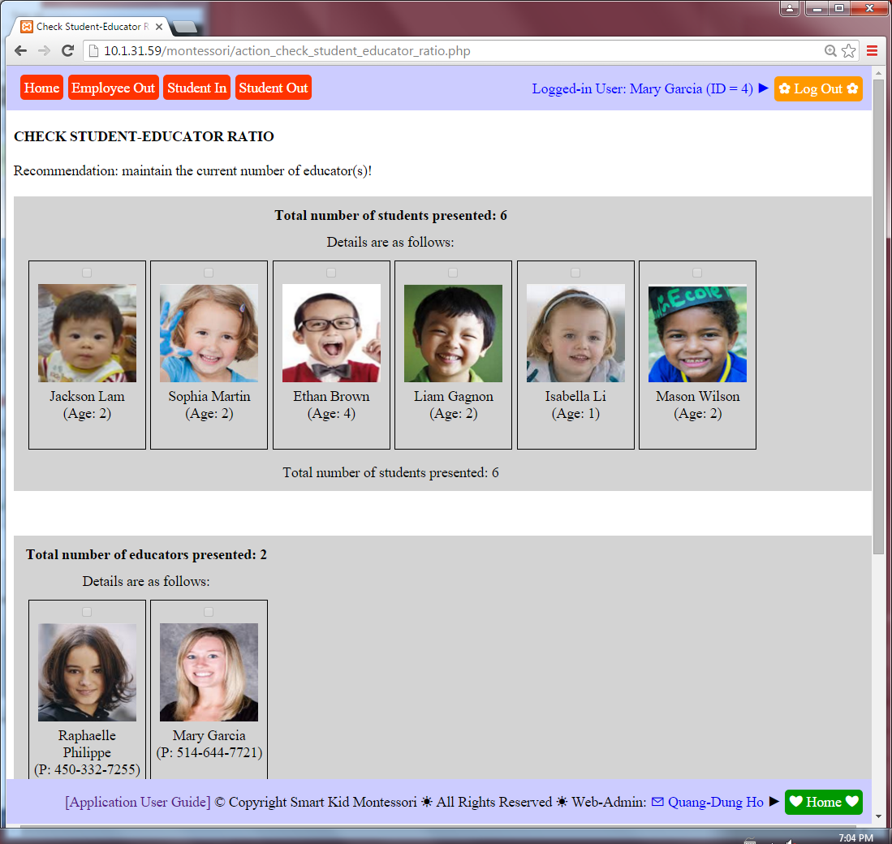
User Guide
Check Student-Educator Ratio & Recommendation

Slide 40
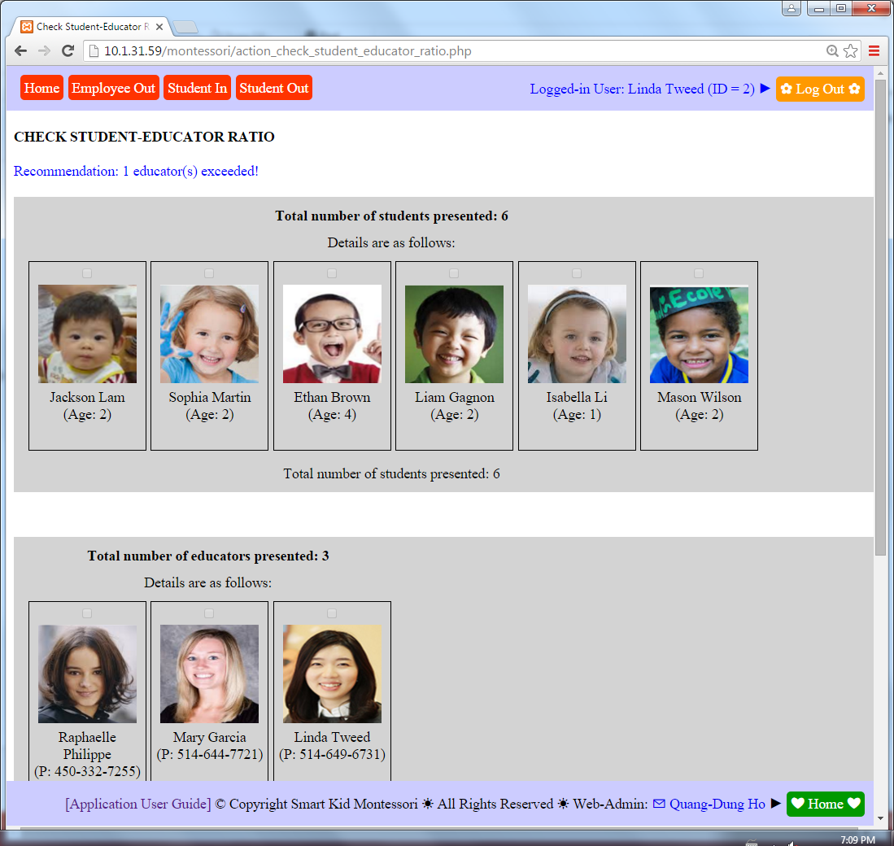
User Guide
Check Student-Educator Ratio & Recommendation

Slide 41
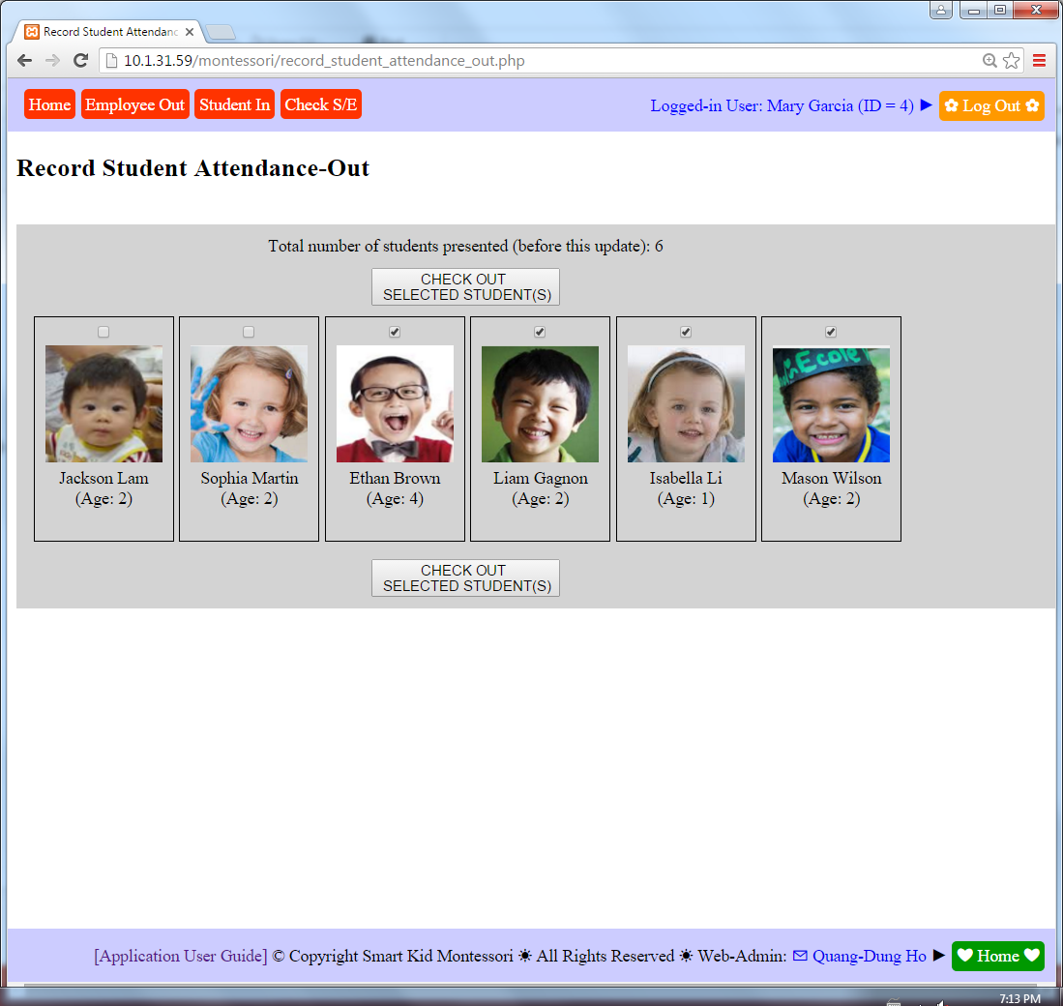
User Guide
Student attendance check-out

Slide 42
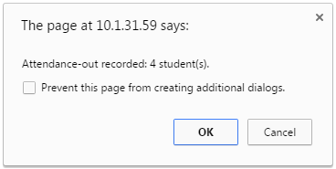
User Guide
Student attendance check-out

Slide 43
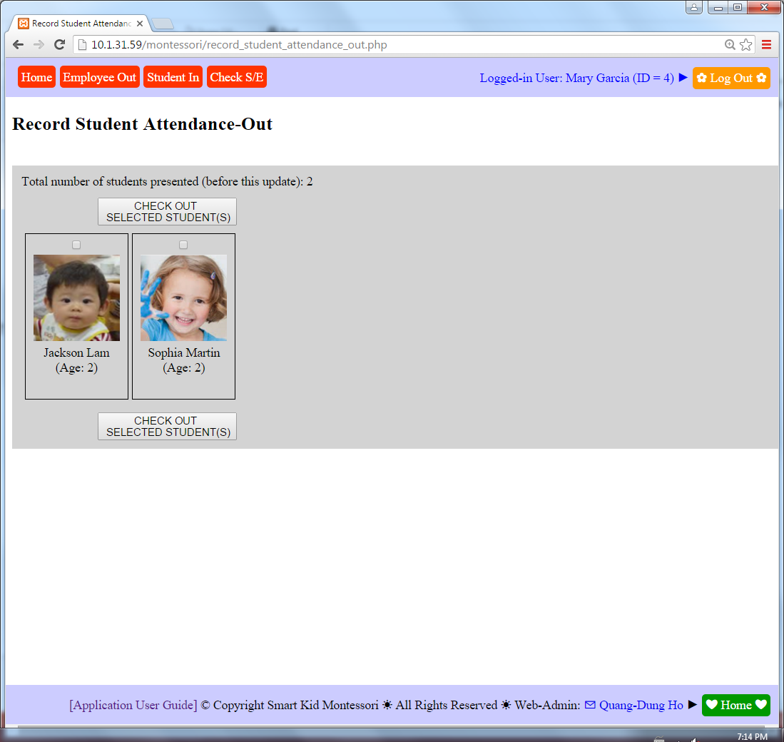
User Guide
Student attendance check-out

Slide 44
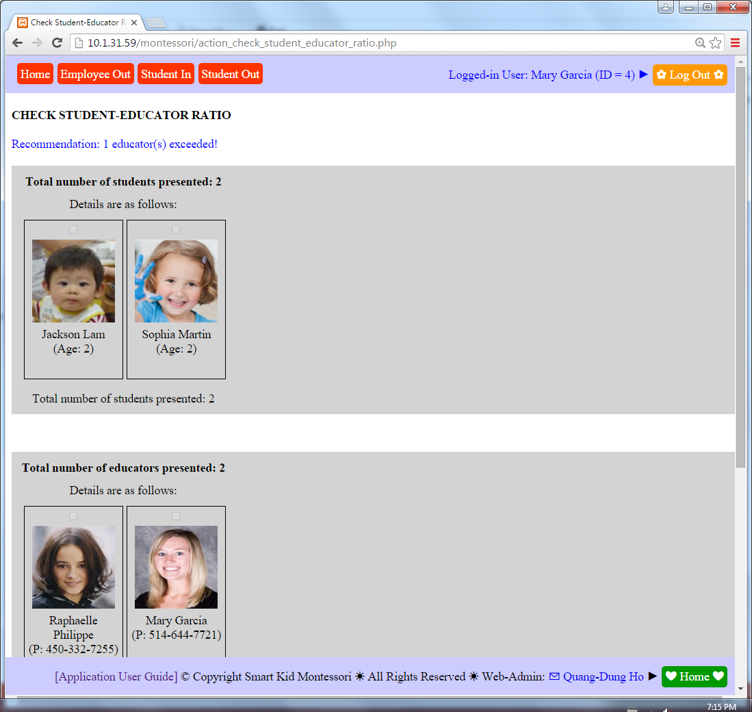
User Guide
Check Student-Educator Ratio & Recommendation

